Slide 1
Organization Visit: Jamuna Bank
Course name: Business Studies for Engineers
Course code: BUS 405
Supervised by-
Mr. Md. Iftekharul Amin
Assistant Professor
Institute of Business Administration
University Of Dhaka

Slide 2
Presented by
Group Number-03
▪Abdullah Al Jubaer (BSSE0812)
▪Tulshi Das (BSSE0811)
▪Sefat E Mahadi (BSSE0839)

Slide 3
Presentation Outline
Aim of the visit
About the Organization
Office Description
Hierarchical Structure
Recruitment System
Culture of Organization
Employee Termination

Slide 4
Aim of the Visit
To study the organizational culture
Know about the structure of an organization
Get an idea about the relationship between manager and employees
Know about environment of an organization

Slide 5
About The Organization: Jamuna Bank
A 3rd generation bank of Bangladesh
The Bank started its operation from 3rd June 2001
The Bank offers both conventional and Islamic banking through designated branches
The Bank provides all types of support to trade, commerce, industry and overall business of the country.

Slide 6
Jamuna Bank Focuses On
Developing human capital
Managing change
Remaining with time
Creating true customer’s value

Slide 7
Mission and Vision
To become a leading banking institution and to play a significant role in the development of the country.
The Bank is committed for satisfying diverse needs of its customers through an array of products at a competitive price by using appropriate technology and providing timely service so that a sustainable growth, reasonable return and contribution to the development of the country can be ensured with a motivated and professional work-force

Slide 8
Organizational Structure
The bank manages its business and operation vertically from the head office through 5 distinct types of banking
Corporate Banking
Islamic Banking
International Banking
SME Banking
NRB Banking

Slide 9
Office Description
Location
Hadi Mansion 2
Dilkusha C/A
Dhaka-1000,Bangladesh

Slide 10
Managerial Hierarchy (management level)
C
Chairman
Vice Chairman
Board Of
Directors
Deputy
Managing
Director
Additional
Managing
Director
Managing
Director

Slide 11
Managerial Hierarchy (executive and operational level)
DMD
SEVP
EVP
SVP
VP
EO
SEO
AVP
SVP
FVP
SO
Officer
Junior
Officer

Slide 12
Recruitment Policies
All permanent employees are hired through job circulation on newspaper
Employees with no prior experience are aptitude tested
Eligible applicants are interviewed
Successful applicants are sent offer letters
Offer letter contains all the terms of employment and organizational regulations

Slide 13
Orienting new employees
All new employees must go through a two day long orientation program on Anti Money Laundering, Green Banking and other relevant required topics
Current employees of the department are encouraged to hold informal workplace related discussions with new employees on topics such as goal, vision and history of the company
Dress code for male employees: full sleeve tucked in shirt along with formal pair of pants and a shoe that covers the entire feet.

Slide 14
Culture of the Organization
Credit and ownership is always given to innovative ideas
Employees with innovative ideas are assigned leading roles in transforming their ideas into reality
All tasks must be approved by immediate line manager
Policies have been known to change based on feedback collected from employees

Slide 15
Informal Culture of the Organization
Many employees have their own workplace nicknames
Birthdays are celebrated by cutting cakes and giving cards both of which are sponsored by the employee’s immediate in line manager
“Cricket Match”, “Football Match”, “Carom Competition” are held on occasionally

Slide 16
Employee Termination
Employees are dismissed if and only if they are known to have made a significant mistake
Employees can quit their work, be terminated from work or be dismissed
Informally an employee might be pressurized to quit his job by his superiors, if he performs poorly

Slide 17
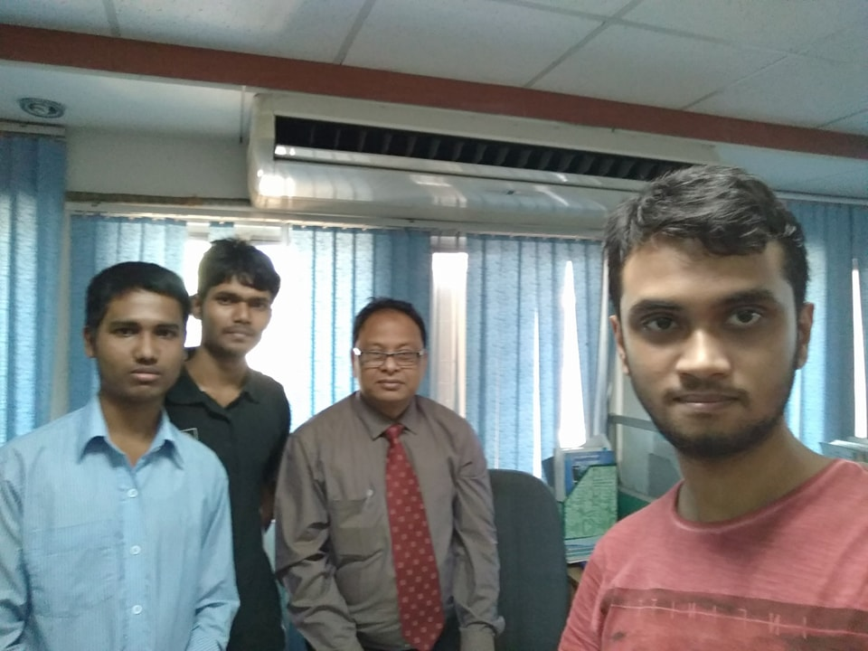
Images from the visit
With Suvash Chandra Dash, Associate Manager,Human Resource Division

Slide 18
Thank You

